Slide 1
Stacks
Using Stacks for Remote Database Access
University of Central Florida
COP 4331

Slide 2
What are Stacks
Stacks are related technologies that can be used to create applications.
In this class we will use them to access remote databases.
The three major types:
WISA: Windows, Internet Information Server, Sql Server, and ASP.NET
LAMP: Linux, Apache, MySQL, PHP
MEAN: MongoDB, Express, Angular, Node.js

Slide 3
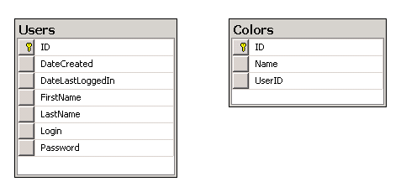
Getting Started
This sample application allows users to login, search for colors, and add colors.
The database has two tables: Users and Colors

Slide 4
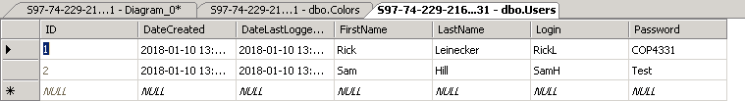
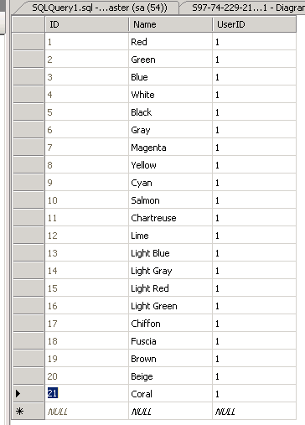

Slide 5
The All-Important JSON
When exchanging data between a browser and a server, the data can only be text.
JSON is text, and we can convert any JavaScript object into JSON, and send JSON to the server.
We can also convert any JSON received from the server into JavaScript objects.
This way we can work with the data as JavaScript objects, with no complicated parsing and translations.

Slide 6
JSON JavaScript Example
{ "name":"John", "age":31, "city":"New York" };
Code:
function useJSON( name, age, city )
{
var newObject =
{ "name":name, "age":age, "city":city };
var jsonData = JSON.stringify(newObject);
// Now use the JSON in network communication
// Alternative JSON creation.
var jsonPayload = '{"color" : "' + newColor + '", "userId" : ' + userId + '}';
}

Slide 7
Network Communications
You can do synchronous or asynchronous calls – asynchronous calls are preferred.
Synchronous:
var xhr = new XMLHttpRequest();
xhr.open("POST", url, false);
xhr.setRequestHeader("Content-type", "application/json; charset=UTF-8");
try
{
xhr.send(jsonPayload);
var jsonObject = JSON.parse( xhr.responseText );
}
catch(err)
{
// Process err.message
}

Slide 8
Network Communications
Asynchronous:
var xhr = new XMLHttpRequest();
xhr.open("POST", url, true);
xhr.setRequestHeader("Content-type",
"application/json; charset=UTF-8");
try
{
xhr.onreadystatechange = function()
{
if (this.readyState == 4 && this.status == 200)
{
var jsonObject = JSON.parse( xhr.responseText );
}
};
xhr.send(jsonPayload);
}
catch(err)
{
// Process err.message
}

Slide 9
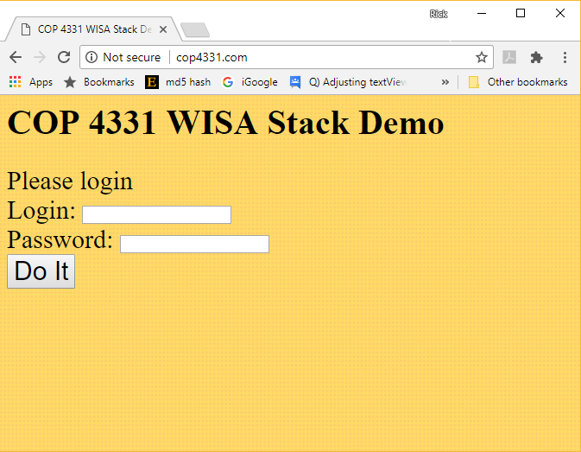
Simple Web-Based Client

Slide 10
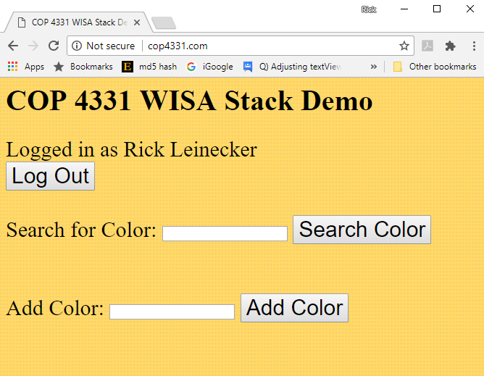

Slide 11
function doLogin()
{
var login = document.getElementById("loginName").value;
var password = document.getElementById("loginPassword").value;
document.getElementById("loginResult").innerHTML = "";
var jsonPayload = '{"login" : "' + login + '", "password" : "' + password + '"}';
var url = urlBase + '/Login.aspx';
var xhr = new XMLHttpRequest();
xhr.open("POST", url, false);
xhr.setRequestHeader("Content-type", "application/json; charset=UTF-8");
try
{
xhr.send(jsonPayload);
var jsonObject = JSON.parse( xhr.responseText );
userId = jsonObject.id;
if( userId < 1 )
{
document.getElementById("loginResult").innerHTML = "User/Password combination incorrect";
return;
}
firstName = jsonObject.firstName;
lastName = jsonObject.lastName;
document.getElementById("userName").innerHTML = firstName + " " + lastName;
document.getElementById("loginName").value = document.getElementById("loginPassword").value = "";
hideOrShow( "loggedInDiv", true);
hideOrShow( "accessUIDiv", true);
hideOrShow( "loginDiv", false);
}
catch(err)
{
document.getElementById("loginResult").innerHTML = err.message;
}
}

Slide 12
function addColor()
{
var newColor = document.getElementById("colorText").value;
document.getElementById("colorAddResult").innerHTML = "";
var jsonPayload =
'{"color" : "' + newColor + '", "userId" : ' + userId + '}';
var url = urlBase + '/AddColor.aspx';
var xhr = new XMLHttpRequest();
xhr.open("POST", url, true);
xhr.setRequestHeader("Content-type", "application/json; charset=UTF-8");
try
{
xhr.onreadystatechange = function()
{
if (this.readyState == 4 && this.status == 200)
{
document.getElementById("colorAddResult").innerHTML =
"Color has been added";
}
};
xhr.send(jsonPayload);
}
catch(err)
{
document.getElementById("colorAddResult").innerHTML = err.message;
}
}

Slide 13
function searchColor()
{
var srch = document.getElementById("searchText").value;
document.getElementById("colorSearchResult").innerHTML = "";
var colorList = document.getElementById("colorList");
colorList.innerHTML = "";
var jsonPayload = '{"search" : "' + srch + '"}';
var url = urlBase + '/SearchColors.aspx';
var xhr = new XMLHttpRequest();
xhr.open("POST", url, true);
xhr.setRequestHeader("Content-type", "application/json; charset=UTF-8");
try
{
xhr.onreadystatechange = function()
{
if (this.readyState == 4 && this.status == 200)
{
hideOrShow( "colorList", true );
document.getElementById("colorSearchResult").innerHTML = "Color(s) has been retrieved";
var jsonObject = JSON.parse( xhr.responseText );
var i;
for( i=0; i<jsonObject.results.length; i++ )
{
var opt = document.createElement("option");
opt.text = jsonObject.results[i];
opt.value = "";
colorList.options.add(opt);
}
}
};
xhr.send(jsonPayload);
}
catch(err)
{
document.getElementById("colorSearchResult").innerHTML = err.message;
}
}

Slide 14
Creating Sql Server Database
A script was created to easily create the database on the server.
This was created locally and then copied to the server for convenience.
CREATE TABLE [dbo].[Users](
[ID] [int] IDENTITY(1,1) NOT NULL,
[DateCreated] [datetime] NOT NULL,
[DateLastLoggedIn] [datetime] NOT NULL,
[FirstName] [nvarchar](50) NOT NULL,
[LastName] [nvarchar](50) NOT NULL,
[Login] [nvarchar](50) NOT NULL,
[Password] [nvarchar](50) NOT NULL
) ON [PRIMARY]
…
etc

Slide 15
Last Step for WISA: ASP.NET API
There are three API calls:
Login
AddColor
SearchColors

Slide 16
API Structure
Deserialize incoming JSON
Perform SQL queries based on incoming JSON data
Create data structure to return
Serialize the return data structure
Send serialized data back

Slide 18
A Note on Passwords
Even though these demos send passwords over the network as plaintext, that is not the correct procedure.
Passwords should always be hashed when they are sent over the network. (I usually use MD5)
Passwords should also be stored in the database as a hash.

Slide 19
Client Code Review

Slide 20
WISA API Code Review

Slide 21
LAMP API Code Review

Slide 22

Questions

